Slide 1

Introduction to JavaScript and TypeScript

Slide 2


Course: Introduction to JavaScript and TypeScript
Lecture on: Hands-on Coding Session
Instructor: Aquib Ajani

Slide 3

COURSE ROADMAP
Introduction to JavaScript (JS)
Strings in JS
Hands-on Coding Session
Arrays, Objects and Functions in JS - I
Arrays, Objects and Functions in JS - II
Classes in JS
OOPs using JS
Hoisting, Scope and Closure - I
Callbacks
Hands-on Coding Session
Promises
Hands-on Coding Session
ES6 - I
ES6 - II

Slide 4
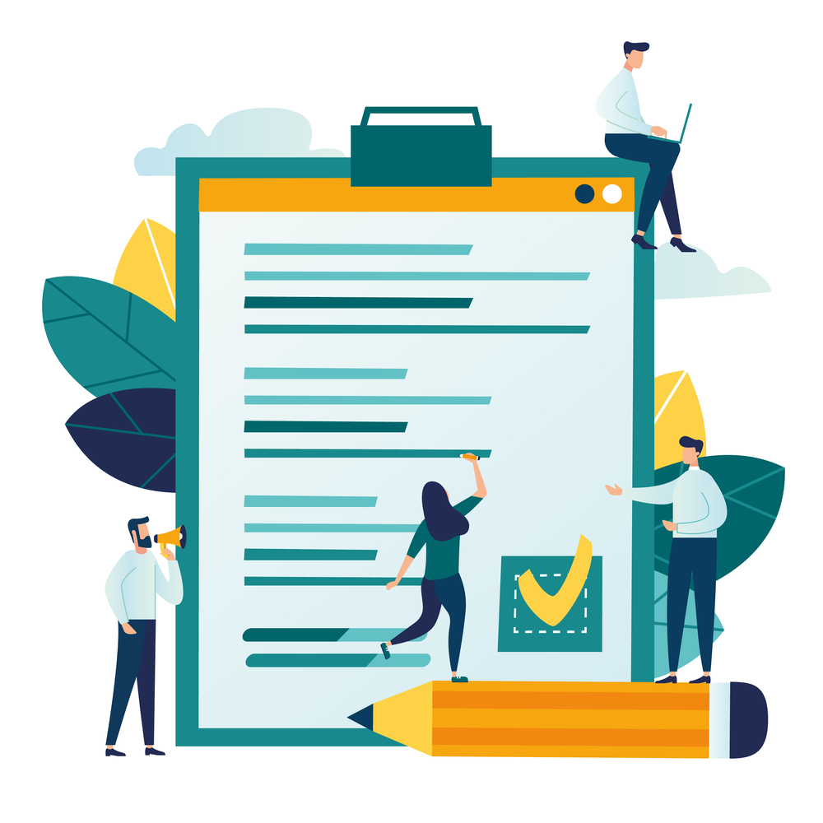
TODAY’S AGENDA
Solve JS Problems

Slide 5
Let’s Solve some of the basic problems in JS

Slide 6
PROBLEM-SOLVING
Write a JavaScript program to test whether the first character of a string is uppercase or not
GitHub link to the Solution
Write a JavaScript program to check a credit card number
GitHub link to the Solution
Write a pattern that matches e-mail addresses
GitHub link to the Solution
Write a JavaScript function to check whether a given value is IP value or not
GitHub link to the Solution

Slide 7
PROBLEM-SOLVING
Write a JavaScript function to check whether a given value is a valid URL or not
GitHub link to the Solution
Write a JavaScript program to sort a list of elements using Quick sort
GitHub link to the Solution
Write a JavaScript program to sort a list of elements using the Selection sort algorithm
GitHub link to the Solution
Write a JavaScript program to sort the characters in a string alphabetically
GitHub link to the Solution

Slide 8
PROBLEM-SOLVING
Write a JavaScript program to find the highest index at which a value should be inserted into an array, in order to maintain its sort order
GitHub link to the Solution
Write a JavaScript program to find duplicate values in a JavaScript array
GitHub link to the Solution
Given an array of integers of size ‘n’. Our aim is to calculate the maximum sum of ‘k’ consecutive elements in the array
GitHub link to the Solution

Slide 9
KEY TAKEAWAYS
Understood the problem-solving process
Solved some problems using JS

Slide 10
TASKS TO COMPLETE AFTER THE SESSION
Coding questions

Slide 11
Thank You!

